Slide 1
Ridiko
A Messenger chat bot that saves money, time and CO².
Created by:
Emil Dudev - 81344
Denitsa Slavcheva - 81275
Veselin Stoyanov - 81239

Slide 2
Table of contents
What is Ridiko?
Use Cases
Architecture
Technologies
Demo
Questions

Slide 3

What is ridiko?

Slide 4
What is Ridiko?
Carpooling is popular
Trips are organised through Facebook Groups
No interest in carpooling websites or mobile apps
Messenger Platform to the rescue!

Slide 5
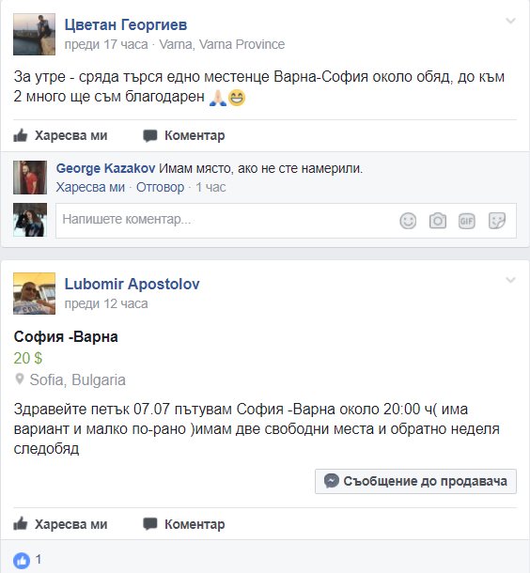
Before Ridiko

Slide 6
After Ridiko

Slide 7
Use Cases
Passenger searches for a trip
Driver searches for passengers
Automated flows for both drivers and passengers
Trusted network of carpoolers

Slide 8
Architecture
Chat Bot Server
Web Server
GraphQL Server
RDBMS

Slide 9
Technologies

Slide 10
Demo time!

Slide 11
Questions?

